Slide 1
Statistical Methods for Data Analysis
Random numbers with ROOT and RooFit
Luca Lista
INFN Napoli

Slide 2
ROOT Random number generators
TRandom
  “basic Random number generator class (periodicity = 10⁹). Note that this is a very simple generator (linear congruential) which is known to have defects (the lower random bits are correlated) and therefore should NOT be used in any statistical study.”
TRandom3
  “based on the "Mersenne Twister generator", and is the recommended one, since it has good random proprieties (period of 2¹⁹⁹³⁷−1, about 10⁶⁰⁰⁰) and it is fast.”
TRandom1
  “based on the RANLUX algorithm, has mathematically proven random proprieties and a period of about 10¹⁷¹. It is however slower than the others.”
TRandom2
  “is based on the Tausworthe generator of L'Ecuyer, and it has the advantage of being fast and using only 3 words (of 32 bits) for the state. The period is 10²⁶.”

Slide 3
Generating with standard PDF’s
Provided methods of TRandomN objects:
  Exp(tau)
  Integer(imax)
  Gaus(mean, sigma)
  Rndm()
  RndmArray(n, x)
  Uniform(x)
  Uniform(x1, x2)
  Landau(mpv, sigma)
  Poisson(mean)
  Binomial(ntot, prob)

Slide 4
Generators in ROOT::Math
Generators provided based on GSL (GNU Scientific Library)
Same interface as TRandomN
Different generators supported via template parameter (RANLUX, by F.James, in this case)
  ROOT::Math::Random<GSLRngRanLux> r;
  Double x = r.Uniform();

Slide 5
Generate random from a TF1
ROOT provides tools to generate random number according to a TF1
  TF1 f(…);
  double x = f.GetRandom();
  TH1D histo(…);
  histo.FillRandom(f, 1000);
Adopted technique: binned cumulative inversion
Caveat: approximations may depend on internal function binning.
  Can change it using: f.Npx(5000);

Slide 6
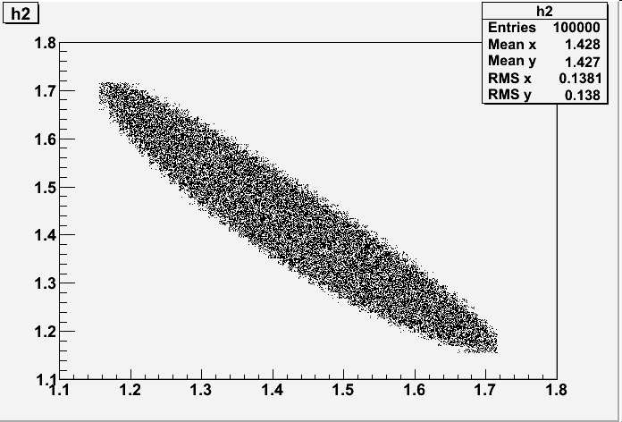
Generate according to phase-spaces
Original implementation: GENBOD function (W515 from CERNLIB) using the Raubold and Lynch method
Implemented in ROOT with TGenPhaseSpace class
TLorentzVector target(0.0, 0.0, 0.0, 0.938);
TLorentzVector beam(0.0, 0.0, .65, .65);
TLorentzVector W = beam + target;
//(Momentum, Energy units are Gev/C, GeV)
Double_t masses[3] = { 0.938, 0.139, 0.139 };
TGenPhaseSpace event;
event.SetDecay(W, 3, masses);
TH2F *h2 = new TH2F("h2","h2",
50,1.1,1.8, 50,1.1,1.8);
for (Int_t n=0;n<100000;n++) {
Double_t weight = event.Generate();
TLorentzVector *pProton = event.GetDecay(0);
TLorentzVector *pPip = event.GetDecay(1);
TLorentzVector *pPim = event.GetDecay(2);
TLorentzVector pPPip = *pProton + *pPip;
TLorentzVector pPPim = *pProton + *pPim;
h2->Fill(pPPip.M2() ,pPPim.M2() ,weight);
}
h2->Draw();

Slide 7
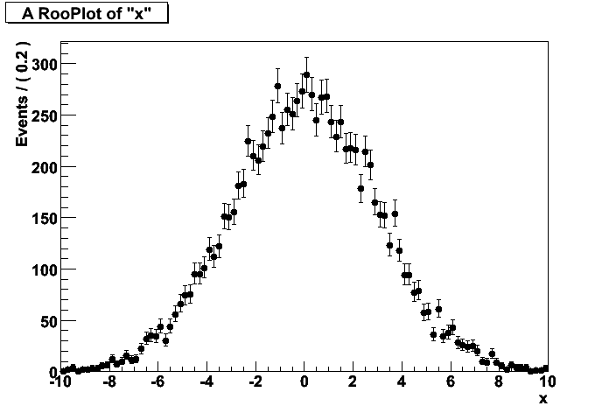
Random generation in RooFit
Each PDF is instrumented with methods to generate random samples
  RooGaussian gauss("gauss","gaussian PDF",
  x, mu, sigma);
  RooDataSet* data = gauss.generate(x, 10000);
  RooPlot* xframe = x.frame();
  data->plotOn(xframe);
  xframe->Draw();
Hit or miss method is used by
default, except for optimized
cases (Gaussian, ecc.)
Optimized implementations for:
  PDF sum, product
  Convolutions
Users can define a specialized
random generator for custom
PDF definitions

Slide 8
References
RANLUX
  F. James, “RANLUX: A Fortran implementation of the high-quality pseudo-random number generator of Lüscher”, Computer Physics Communications, 79 (1994) 111–114
GSL random generators:
  http://www.gnu.org/software/gsl/manual/html_node/Random-number-generator-algorithms.html
  http://www.gnu.org/software/gsl/manual/html_node/Random-Number-Distributions.html
ROOT Math generator documentation:
  http://project-mathlibs.web.cern.ch/project-mathlibs/sw/html/group__Random.html
RooFit online tutorial
  http://roofit.sourceforge.net/docs/tutorial/
  index.html
Credits:
  RooFit slides and examples extracted, adapted and/or inspired by original presentations by Wouter Verkerke

